Slide 1
Draft Measurement
International Rating Certificate

Slide 2
Draft Condition
Boat in accordance with IRC Rule 17
Boat ashore and afloat
Boat in level trim
Better to start ashore to determine the lowest point of the keel
drop keel boat: measurements with the keel fully up and fully down.
Notes:
The boat will need to be seen by the measurer both ashore and afloat. It doesn't matter which is first. It is better to start ashore to determine the lowest point of the keel As with overhangs, draft is measured in IRC measurement condition (see IRC Rule 17).
If measuring a drop keel boat, measurements will be needed with the keel fully up and fully down.

Slide 3
Draft Equipment
Tape measure
Floating (wooden) ruler
Spirit level
2 plumb bobs
Sundry string
Tape
Notes:
List equipment needed

Slide 4
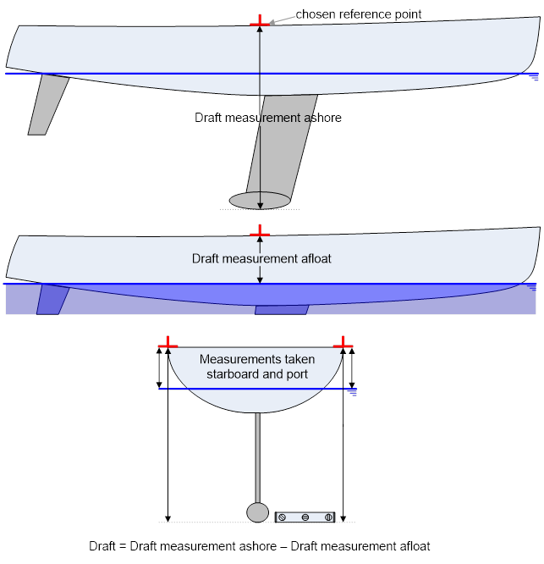
Draft Measurement

Slide 5
Draft Ashore
Level trim
Establish a reference point above the waterline at maximum keel depth.
Using a spirit level, project horizontally from the underside of the keel outboard to vertically below the reference point each side.
Measure vertically down from each reference point.
Alternatively a surveyor's level may be used.
Notes:
Ensuring first that the boat is in level trim, establish a convenient reference point on each side of the boat above the waterline in way of the section at maximum keel depth. Using a spirit level, project horizontally from the underside of the keel outboard to vertically below the reference point each side. Measure vertically down from each reference point. Alternatively, if available, a surveyor's level may be used.
Draft ashore is actually measuring the total of the draft plus freeboard of your reference point

Slide 6
Draft Afloat
Ensure first that the boat is in measurement condition (IRC rule 17)
Everybody off the boat!
Level trim: fore and aft and athwartships.
If doing afloat first, mark the reference points on the hull.
Using a wooden ruler, measure vertically downwards from the reference point each side to the water surface.
Notes:
Ensure first that the boat is in measurement condition (IRC rule 17), that everybody is off the boat(!), and that the boat is in level trim both fore and aft and athwartships. If doing the afloat measurement first, mark the reference points on the hull as above.
Draft afloat is actually measuring freeboard to your reference point.
Using a wooden ruler, measure vertically downwards from the reference point each side to the water surface.

Slide 7
Draft Calculation
Subtract afloat freeboard from ashore draft, and then averaging the results, draft is found.
Draft (Stbd & Port) = Draft & Freeboard Ashore – Freeboard Afloat
Draft = (Draft Port + Draft Starboard) / 2
Notes:
By subtraction from the ashore figures, and then averaging the results, draft is found.

